Slide 1
Naïve Bayes
The Task of Text Classification

Slide 2
Male or female author?
By 1925 present-day Vietnam was divided into three parts under French colonial rule. The southern region embracing Saigon and the Mekong delta was the colony of Cochin-China; the central area with its imperial capital at Hue was the protectorate of Annam…
Clara never failed to be astonished by the extraordinary felicity of her own name. She found it hard to trust herself to the mercy of fate, which had managed over the years to convert her greatest shame into one of her greatest assets…
S. Argamon, M. Koppel, J. Fine, A. R. Shimoni, 2003. “Gender, Genre, and Writing Style in Formal Written Texts,” Text, volume 23, number 3, pp. 321–346
Notes:
#1: Saigon. Grey, Anthony
#2: Jerusalem the Golden. Drabble, Margaret
From shlomo argamon

Slide 3


Positive or negative movie review?
unbelievably disappointing
Full of zany characters and richly applied satire, and some great plot twists
this is the greatest screwball comedy ever filmed
It was pathetic. The worst part about it was the boxing scenes.

Slide 4
What is the subject of this article?
MEDLINE Article
MeSH Subject Category Hierarchy
Antogonists and Inhibitors
Blood Supply
Chemistry
Drug Therapy
Embryology
Epidemiology
…
?

Slide 5
Text Classification
Assigning subject categories, topics, or genres
Spam detection
Authorship identification
Age/gender identification
Language Identification
Sentiment analysis
…

Slide 6
Text Classification: definition
Input:
a document d
a fixed set of classes C = {c₁, c₂,…, c_{J}}
Output: a predicted class c ∈ C

Slide 7
Classification: Supervised Machine Learning
Input:
a document d
a fixed set of classes C = {c₁, c₂,…, c_{J}}
A training set of m hand-labeled documents (d₁,c₁),....,(d_{m},c_{m})
Output:
a learned classifier γ:d → c

Slide 8
Classification Methods: Supervised Machine Learning
Any kind of classifier
Naïve Bayes
Logistic regression
k-Nearest Neighbors
Neural Networks
Support Vector Machines
…

Slide 9
Text Classification and Naïve Bayes
Naïve Bayes

Slide 10
Naïve Bayes
Simple (“Naïve”) classification method based on the Bayes Rule
Consider a very simple representation of document
Bag of words (BoW)

Slide 11
The bag of words representation
I love this movie! It's sweet, but with satirical humor. The dialogue is great and the adventure scenes are fun… It manages to be whimsical and romantic while laughing at the conventions of the fairy tale genre. I would recommend it to just about anyone. I've seen it several times, and I'm always happy to see it again whenever I have a friend who hasn't seen it yet.
γ(
)=c

Slide 12
The bag of words representation
I love this movie! It's sweet, but with satirical humor. The dialogue is great and the adventure scenes are fun… It manages to be whimsical and romantic while laughing at the conventions of the fairy tale genre. I would recommend it to just about anyone. I've seen it several times, and I'm always happy to see it again whenever I have a friend who hasn't seen it yet.
γ(
)=c

Slide 13
The bag of words representation: using a subset of words
x love xxxxxxxxxxxxxxxx sweet xxxxxxx satirical xxxxxxxxxx xxxxxxxxxxx great xxxxxxx xxxxxxxxxxxxxxxxxxx fun xxxx xxxxxxxxxxxxx whimsical xxxx romantic xxxx laughing xxxxxxxxxxxxxxxxxxxxxxxxxxxxxxxxxxxxxxxxxxxx recommend xxxxx xxxxxxxxxxxxxxxxxxxxxxxxxxxxxxxx several xxxxxxxxxxxxxxxxx xxxxx happy xxxxxxxxx again xxxxxxxxxxxxxxxxxxxxxxxxxxxxxxxxxxxxxxxxxxxxxxx
γ(
)=c

Slide 14
The bag of words representation
great | 2
love | 2
recommend | 1
laugh | 1
happy | 1
... | ...
γ(
)=c

Slide 15
The bag of words’ assumption
Assume position of words doesn’t matter
An order-less representation

Slide 16
Bag of words for document classification
?
Test
document
Machine Learning
parser
language
label
translation
…
NLP
Garbage
Collection
Planning
GUI
learning
training
algorithm
shrinkage
network...
parser
tag
training
translation
language...
garbage
collection
memory
optimization
region...
planning
temporal
reasoning
plan
language...
...

Slide 17
Text Classification and Naïve Bayes
Formalizing the Naïve Bayes Classifier

Slide 18
Bayes’ Rule Applied to Documents and Classes
For a document d and a class c

Slide 19
Bayes Classifier
MAP is “maximum a posteriori” = most likely class
Bayes Rule
Dropping the denominator

Slide 20
Bayes Classifier
Document d represented as features x1..xn

Slide 21
Bayes Classifier
O(|X|^{n}•|C|) parameters
How often does this class occur?
Could only be estimated if a very, very large number of training examples was available!
We can just count the relative frequencies in a corpus

Slide 22
Multinomial Naïve Bayes Independence Assumption
Conditional Independence: Assume the feature probabilities P(x_{i}|c_{j}) are independent given the class c.

Slide 23
Naïve Bayes Classifier

Slide 24

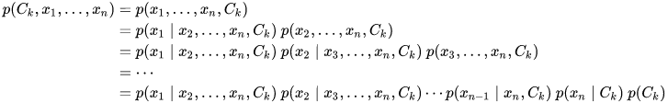
The Independence Assumption Explained
The Bayes’ theorem
The numerator is equivalent to the joint probability model
Using the chain rule for repeated applications of the definition of conditional probability:
https://en.wikipedia.org/wiki/Naive_Bayes_classifier

Slide 25

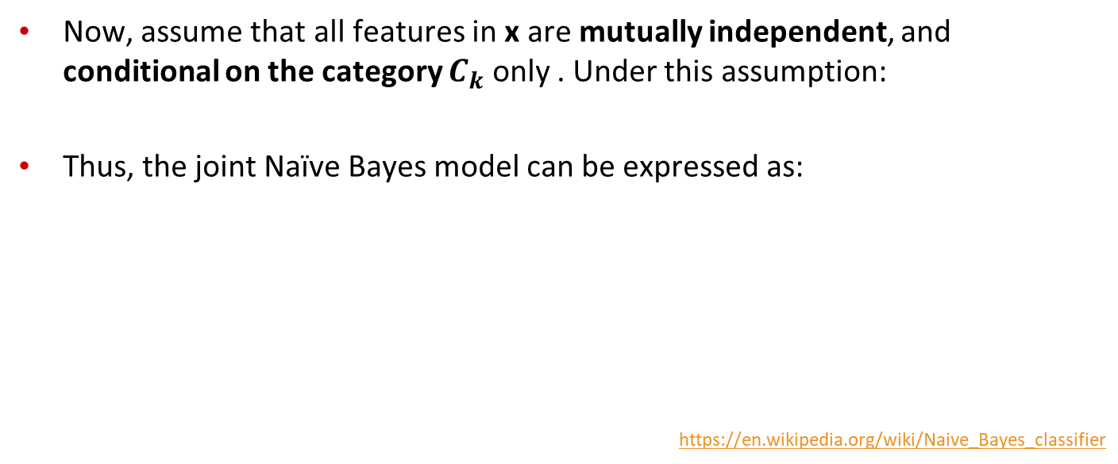
The Independence Assumption Explained
Now, assume that all features in x are mutually independent, and conditional on the category $C_{k}$ only . Under this assumption:
Thus, the joint Naïve Bayes model can be expressed as:
https://en.wikipedia.org/wiki/Naive_Bayes_classifier

Slide 26
Applying Naïve Bayes Classifier to Text Classification
positions ← all vocabulary word positions in test document

Slide 27
Text Classification and Naïve Bayes
Naïve Bayes: Learning

Slide 28
Learning the Naïve Bayes Model (Parameter Estimation)
Sec.13.3
Maximum Likelihood Estimates (MLE)
simply use the frequencies in the data

Slide 29
Parameter Estimation
fraction of times word w_{i} appears
among all vocabulary words in documents of topic c_{j}
Create mega-document for topic j by concatenating all docs in this topic
Use frequency of w_{i} among all vocabulary words in mega-document

Slide 30
Problem with Maximum Likelihood
Sec.13.3
What if we have seen no training documents with the word fantastic and classified in the topic positive (thumbs-up)?
Zero probabilities cannot be conditioned away, no matter the other evidence!

Slide 31
Solution: Laplace Smoothing

Slide 32
Text Classification and Naïve Bayes
Naïve Bayes: An Example

Slide 33
 | Doc | Words | Class
Training | 1 | Chinese Beijing Chinese | c
 | 2 | Chinese Chinese Shanghai | c
 | 3 | Chinese Macao | c
 | 4 | Tokyo Japan Chinese | j
Test | 5 | Chinese Chinese Chinese Tokyo Japan | ?
Priors:
P(c)=
P(j)=
3
4
1
Choosing a class:
P(c|d5)
P(j|d5)
4
3/4 * (3/7)³ * 1/14 * 1/14
≈ 0.0003
Conditional Probabilities:
P(Chinese|c) =
P(Tokyo|c) =
P(Japan|c) =
P(Chinese|j) =
P(Tokyo|j) =
P(Japan|j) =
(5+1) / (8+6) = 6/14 = 3/7
(0+1) / (8+6) = 1/14
1/4 * (2/9)³ * 2/9 * 2/9
≈ 0.0001
(0+1) / (8+6) = 1/14
(1+1) / (3+6) = 2/9
(1+1) / (3+6) = 2/9
(1+1) / (3+6) = 2/9

Slide 34
Summary: Naïve Bayes is Not So Naïve!
Very Fast, low storage requirements
Very good in domains with many equally important features, and limited amount of training data
Optimal if the independence assumption holds
If the assumed independence is correct, then it is the Bayes Optimal Classifier for the problem
A good dependable baseline for different problems

